Slide 1
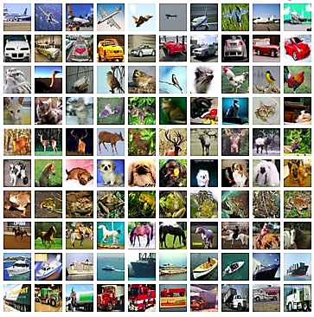
ANIMAL & OBJECT CLASSIFICATION USING ANN & CNN
INDIAN SERVERS ML - INTERNSHIP FINAL PROJECT
By
T. VINEETH KUMAR
[ ID: IndServ21a978 ]

Slide 2
Introduction:
Our project is about the classification of animals and objects from a dataset (cifar10) containing about 60,000 images of 10 different classes (which are randomly distributed over the dataset) . In this project we are using the concept of ANN (Artificial Neural Network) and also CNN (Convolutional Neural Network) . Our objective is to obtain the maximum possible accuracy for our model.

Slide 3
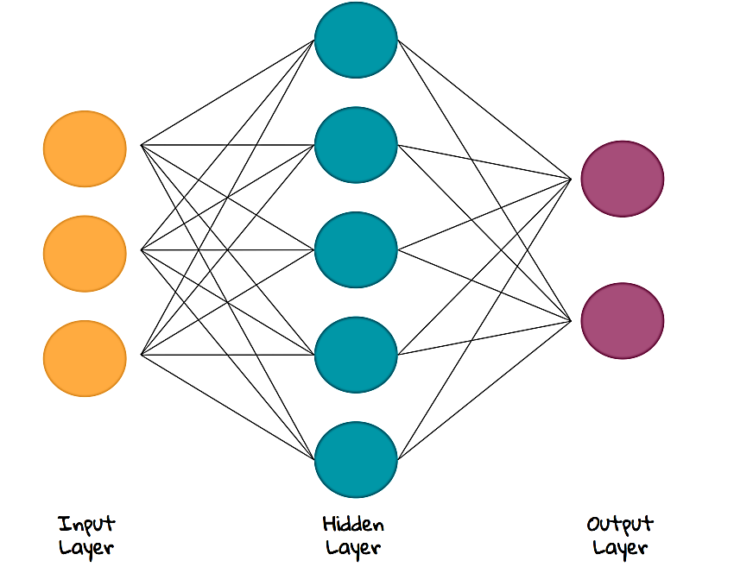
ANN (ARTIFICIAL NEURAL NETWORK)
ANN : An ARTIFICIAL NEURAL NETWORK is usually a computational network based on biological neural network that construct the structure of human brain. Similar to a human brain it has neurons interconnected to each other , artificial neural networks . These neurons are knows as nodes.

Slide 4
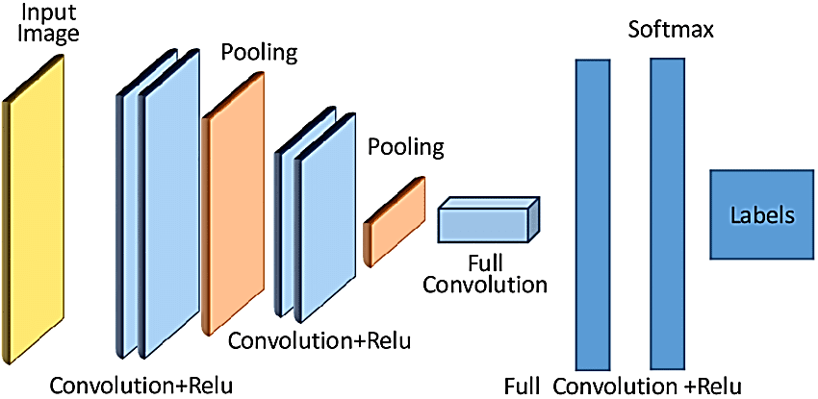
CNN (CONVOLUTIONAL NEURAL NETWORK)
CNN: A CONVOLUTIONAL NEURAL NETWORK is a type of artificial neural network used in image recognition and processing that is specifically designed to process pixel data. The layers of a CNN consist of an input layer, an output layer and a hidden layer that includes multiple convolutional layers, pooling layers, fully connected layers and normalization layers. The removal of limitations and increase in efficiency for image processing results in a system that is far more effective

Slide 5
Approach:
The basic idea of the project is to compare different neural network models on cifar10 dataset and test the accuracy of model to predict an image and its class
Firstly we build a artificial neural network(ANN) which consists of three layers namely flatten and 2 dense layers. We then compile it and train it using the training set and upon testing we get the accuracy of 45 percentage
Next we built a convolution neural network(CNN) using pair of convolution layers and pooling layers followed by dense and flatten layers for the output. This model on testing gives out the accuracy to be nearly 70 percentage and can be increased by increasing the epochs.
Next we compare and display the outputs using classification report
In a nutshell, the classification can be done using both ANN and CNN where as CNN gives us better accuracy

Slide 6
Important libraries Used :
Tensorflow
Keras
Matplotliob
Numpy

Slide 7
Conclusion :
The maximum accuracy we obtained from our CNN model is 78.41% which is very much useful in predicting 8 out 10 images correctly from a random dataset containing images of animals and objects . we can improve the performance accuracy of the CNN model by increasing number of dense or hidden layers inside the neural network . This model can be extended to different classes .

Slide 8


